Slide 1
Artificial Gravity
By Cole Christensen
Notes:
Title page

Slide 2
Overview
Slide 1 - Title Slide
Slide 2 - Overview
Slide 3 - History
Slide 4 - Plan and implementation
Slide 5 - Pro 1
Slide 6 - Con 1
Slide 7 - Problem and why we need artificial gravity
Slide 8 - Problem and why we need artificial gravity
Slide 9 - Summary/Opinion
Slide 10 - References
Notes:
Overveiw

Slide 3
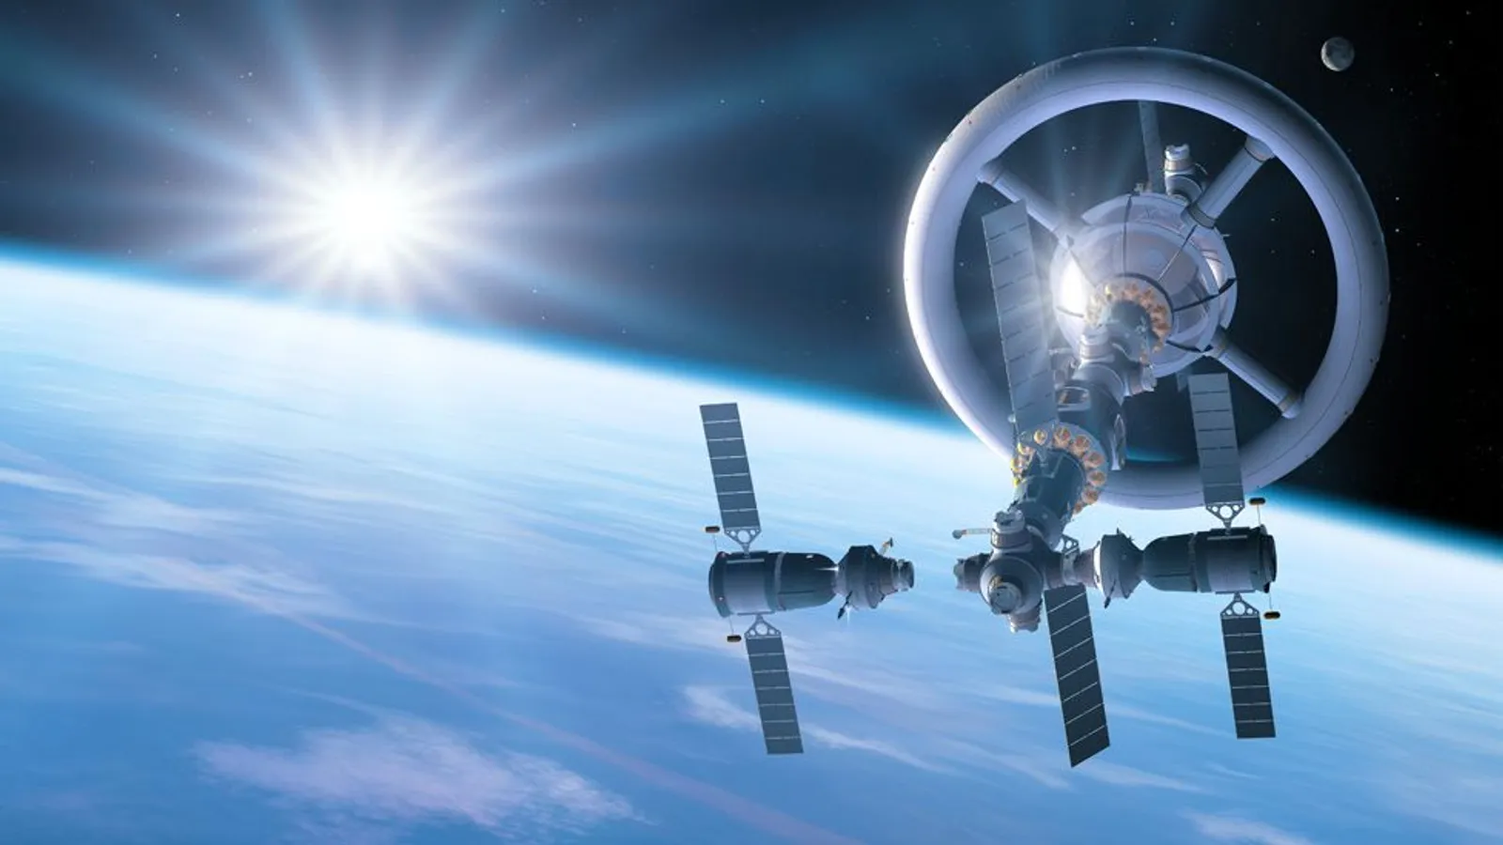
History
So far this has not been tried in the real world. There have been many tests done to test the idea of adding a rotating living quarters into spaceships in order to add gravity but not yet has it been implemented into the real world. So not much history is made around this subject.
Notes:
So far this has not been tried in the real world and is only in the development stage. There have been many tests done to test the idea of adding a rotating living quarters into spaceships but not yet has it been implemented into the real world. So not much history is made around this subject.

Slide 4
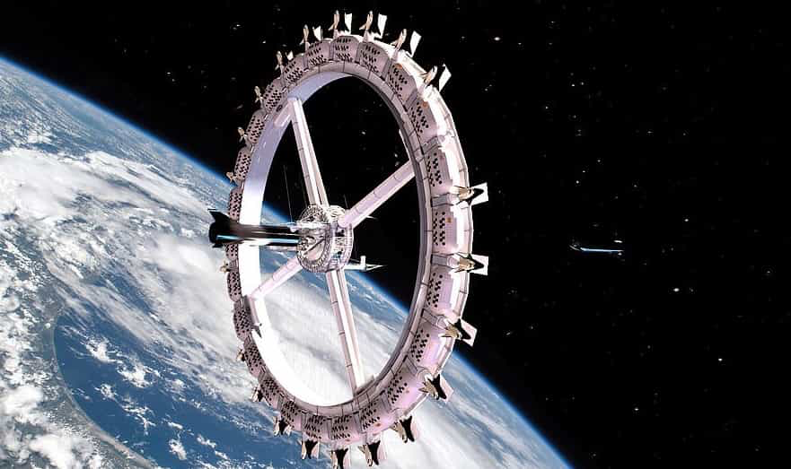
Plan and implantation
There is still a lot of research and development that needs to be done but we can imagine that in the future, when people widespread go into space, there will be some kind of artificial gravity in order to keep the human body structure healthy and the same as on earth
Notes:
There is still a lot of research and development that needs to be done but we can imagine that in the future, when people widespread go into space, there will be some kind of artificial gravity in order to keep the human body structure healthy and the same as on earth

Slide 5

Pro 1
Astronauts no longer have issues with the change coming back to earth with the dramatic change in gravity. This means that less astronauts will pass out or have health issues when they come back from extended time in space.
Notes:
Astronauts no longer have issues with the change coming back to earth with the dramatic change in gravity. This means that less astronauts will pass out or have health issues when they come back from extended time in space.

Slide 6

Con 1
Cost and logistics. It is very hard to get a big spinning spacecraft into space from earth. This will and has taken a lot of money and time and we still cannot put a spacecraft into space with this technology.
Notes:
Cost and logistics. It is very hard to get a big spinning spacecraft into space from earth. This will and has taken a lot of money and time and we still cannot put a spacecraft into space with this technology.

Slide 7
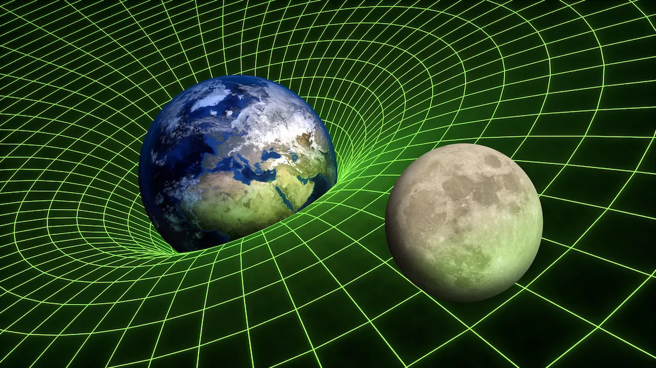
Problem and why we need artificial gravity
When we go into space, the gravity levels are extremely less than on earth. There are a number of things that we know are affected by the loss of gravity or by microgravity. With no gravity, we lose bone mass, bone mineral density, muscle mass. We also lose some of our cardiovascular function.
Notes:
So, in space, there are a number of things that we know are affected by the loss of gravity or by microgravity, and those happen with those systems that we know are affected by gravity. So, we lose bone mass, bone mineral density. We lose muscle mass. We lose some of our cardiovascular function but it's actually hard to measure until people come back to Earth and then we start seeing that there's a change there.

Slide 8
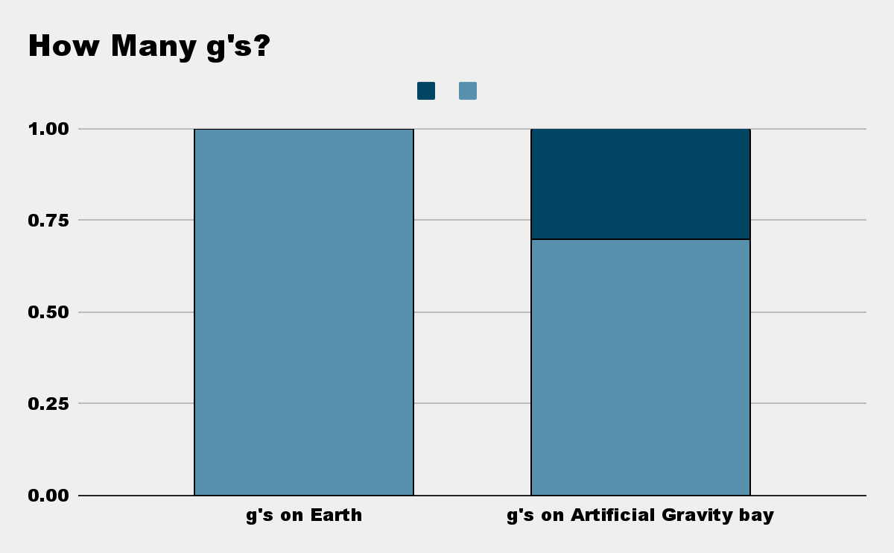
Problem and why we need artificial gravity
We can fix these problems by implementing artificial gravity. This would be done by adding a rotating section of the spaceship adding around 1g of gravity or less.
1g or Gravity - .7g’s of gravity
Notes:
The thought is again that by using artificial gravity we could offset all those affects. By having some kind of the g level, maybe 1 g, maybe less, we don't know exactly what the right g level is, and maybe a rotating station and maybe not, maybe part of the station rotating or maybe just rotating the people inside the station for part of the day. Realize that the gravity effect is predominately when we're upright with respect to the Earth.

Slide 9
Summary/Opinion
I really like the idea of space and I feel that there is definitely a problem when it comes to gravity. I think that the human body needs around one g of gravity in order to be healthy. So I like the idea of this technology. I do think it has a long way to go until it can be put into wide scale use.
Notes:
I really like the idea of space and I feel that there is definitely a problem when it comes to gravity. I think that the human body needs around one g of gravity in order to be healthy. So I like the idea of this technology. I do think it has a long way to go until it can be put into wide scale use.

Slide 10
References
SPACE.COM
NASA.GOV/HWHAP
SENXPLORES.ORG
FRONTIERSIN.ORG

